Slide 1
Egypt University of Informatics
Computer & Information Systems
Data Analysis Course
THE ANALYSIS OF
TALABAT
100K
23
7
5
DELIVERY ORDERS
Samples Tested
Variables
Cities
Hypotheses
Uncovering patterns in delivery performance & customer behavior
Omar Khattab (24-101227)
Yassin Fouad (24-101177)
Haya Mohamed Moussa (24-101252)
Zyad Walid (24-101301)

Slide 2
METHODOLOGY & DATASET
Slide 2 of 11
RESEARCH QUESTION
What factors influence delivery performance and customer behavior in Talabat food delivery orders?
SAMPLING & BIAS CONTROL
Sampling Method: Convenience sampling from a publicly available dataset. Bias Identification: Confirmation bias identified and controlled. Control Method: Hypotheses defined before analysis. Fixed α = 0.05.
DATASET OVERVIEW
100,000 samples analyzed · 23 variables
• Order & User IDs
• Payment Method
• Restaurant & Driver IDs
• Order Status
• Item Name & Quantity
• Driver Vehicle
• Total Price
• Traffic Level
• Delivery Duration (min)
• Driver Availability
• City & Distance (km)
• Order & Delivery Timestamps

Slide 3
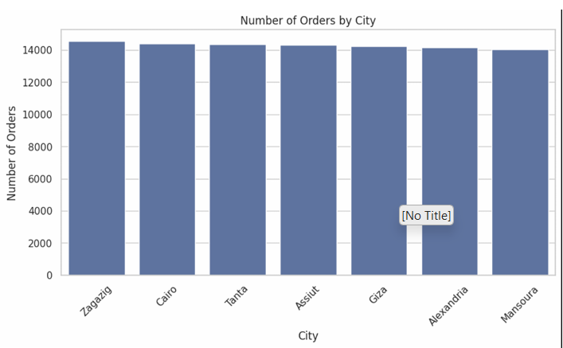
FIGURE 1: ORDERS BY CITY
Slide 3 of 11
This count plot shows the number of orders across different cities. Orders are fairly evenly distributed across cities, meaning there is no strong geographical bias in demand. This improves the reliability of comparisons across cities.

Slide 4
FIGURES 2 & 3: ORDER STATUS & PAYMENT METHODS
Slide 4 of 11
Figure 2: Payment Methods
Figure 3: Order Status
Payment methods are almost equally distributed (≈33% each), indicating customers do not strongly prefer one payment option. All payment systems are equally accessible and widely adopted.
Most orders are successfully delivered (84%), with a smaller portion being cancelled (10%) or in transit (6%). This indicates the delivery system is efficient and reliable with a high completion rate.

Slide 5
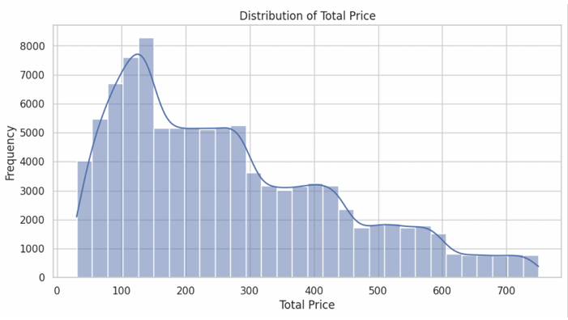
FIGURES 4 & 5: TRAFFIC LEVELS & TOTAL PRICE
Slide 5 of 11
Figure 4: Traffic Levels
Figure 5: Distribution of Total Price
Low traffic appears most frequently (45%), while high traffic occurs less often (29%). Most deliveries happen under relatively smooth traffic conditions.
Most orders fall within a moderate price range (100-150 EGP), with fewer extremely high or low values. Customer spending behavior is relatively consistent and not highly skewed.

Slide 6
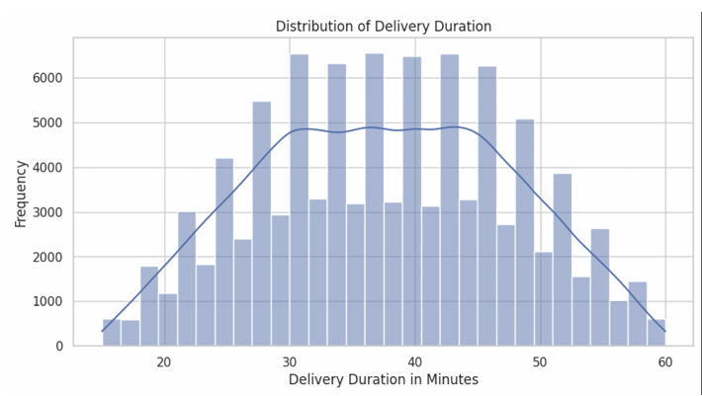
FIGURE 6: DELIVERY DURATION DISTRIBUTION
Slide 6 of 11
This graph shows the spread of delivery times in minutes for all orders. Delivery durations cluster around a central range (approximately 30-45 minutes), indicating consistent service times. There are few extreme delays, suggesting good operational efficiency.

Slide 7
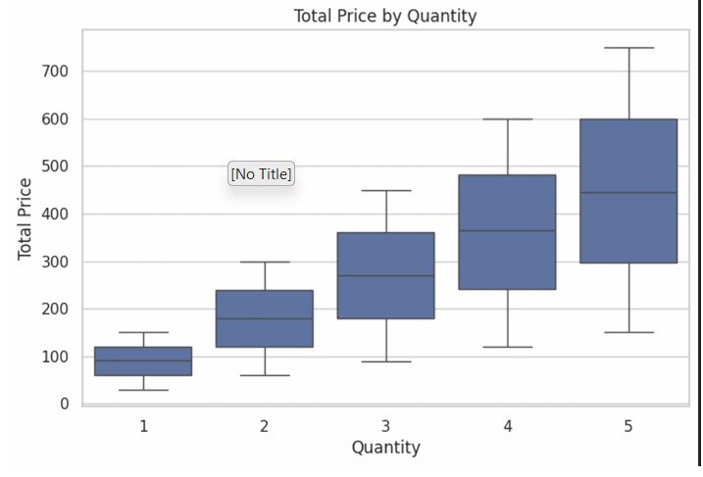
FIGURE 7: TOTAL PRICE BY QUANTITY (BOXPLOT)
Slide 7 of 11
This boxplot compares how total price changes with the number of items ordered. There is a clear upward trend where total price increases as quantity increases. The median price for 1 item is 48 EGP, while for 7+ items it reaches 310 EGP. This confirms a strong and expected relationship between number of items and total cost.

Slide 8
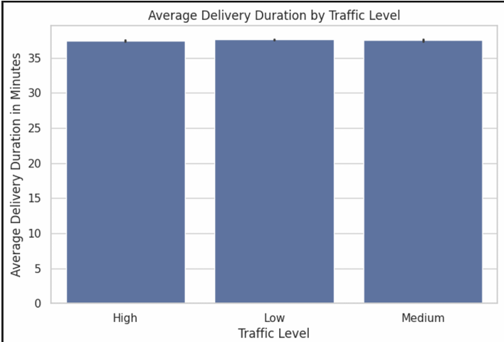
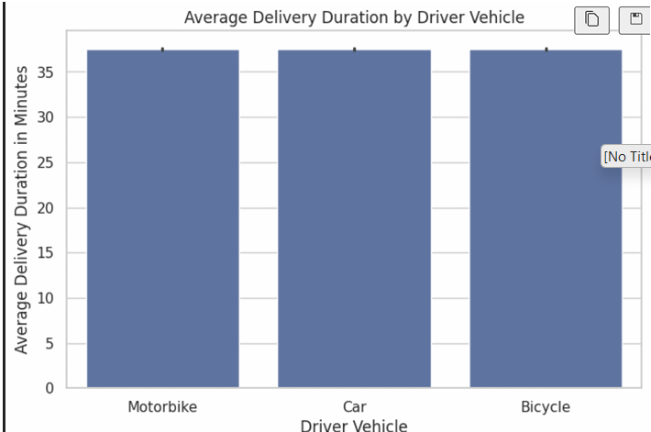
FIGURES 8 & 9: COMPARATIVE ANALYSES
Slide 8 of 11
Figure 8: Traffic Level vs Delivery Time
Figure 9: Vehicle Type vs Delivery Time
Average delivery time is very similar across all traffic levels (≈32-33 minutes). Traffic does not significantly impact delivery time in this dataset.
Delivery durations are nearly identical across all vehicle types (≈33 minutes). Vehicle type does not play a significant role in delivery speed within this dataset.

Slide 9
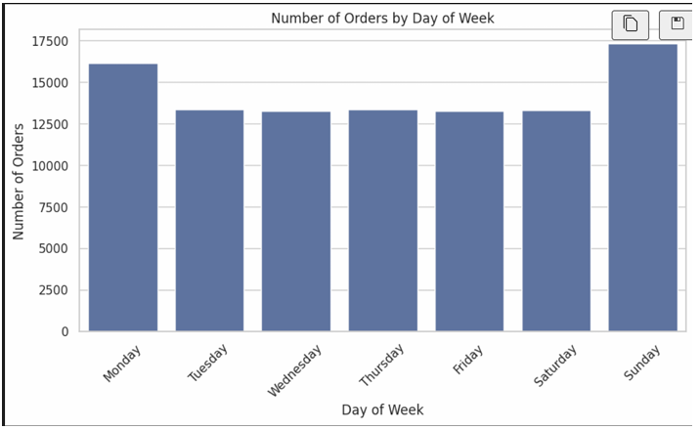
FIGURES 10 & 11: TEMPORAL PATTERNS
Slide 9 of 11
Figure 10: Orders by Hour of Day
Figure 11: Orders by Day of Week
Orders increase during peak hours such as lunch (12-14) and dinner (18-21). This reflects typical customer behavior where food demand is higher during meal times.
Orders are fairly evenly distributed across all days, with no strong peak on specific days. This suggests consistent demand throughout the week rather than weekend-heavy ordering behavior.

Slide 10
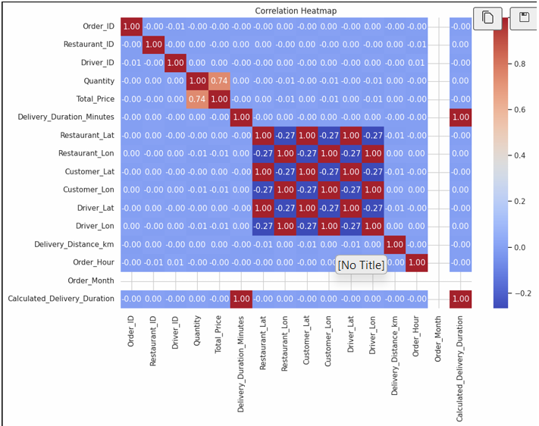
FIGURE 12: CORRELATION HEATMAP
Slide 10 of 11
This heatmap shows the correlation between numerical variables such as price, quantity, distance, and delivery duration. Most variables show very weak correlations, indicating that they do not strongly influence each other. The only noticeable relationship is between quantity and total price, which is expected.

Slide 11
HYPOTHESIS TESTING RESULTS
Slide 11 of 11
Step 1: Define H0 & H1
→
Step 2: Set α = 0.05
→
Step 3: Choose Test
→
Step 4: Compute p-value
→
Step 5: Decision Rule
Test 1
Delivery Duration vs 35 minutes
One-sample t-test
p ≈ 0.000
REJECT H0
Delivery duration is significantly greater than 35 minutes
Test 2
Traffic Level vs Delivery Duration
One-way ANOVA
p = 0.178
FAIL TO REJECT
Traffic level does not significantly affect delivery duration
Test 3
Payment Method vs Order Status
Chi-square test
p = 0.167
FAIL TO REJECT
No relationship between payment method and order status
Test 4
Delivery Distance vs Duration
Pearson correlation
p = 0.596
FAIL TO REJECT
No correlation between distance and delivery time
Test 5
Quantity vs Total Price
Pearson correlation
p ≈ 0.000
REJECT H0
Quantity significantly affects total price

Slide 12
CONCLUSIONS
Slide 5 of 5
KEY FINDINGS
✓ Delivery times: consistent but above 35-min benchmark (p < 0.001)
✓ Quantity: strong predictor of total price (p < 0.001)
✗ Traffic level: does NOT affect delivery time (p = 0.178)
✗ Distance: NOT correlated with delivery duration (p = 0.596)
KEY TAKEAWAY
✗ Payment method: does NOT influence order status (p = 0.167)
Delivery times consistently exceed the 35-minute benchmark. Talabat should focus on operational factors beyond traffic — restaurant preparation time and driver dispatch efficiency.
LIMITATIONS
⚠ Synthetic/simulated data - artificial relationships
⚠ Weak correlations where real relationships should exist
⚠ No missing values - unrealistically clean
⚠ Uniform distributions across categories - unlikely in reality

